Slide 1
Introduction to Web Development

Slide 2
Web sites typically have three tiers
Front end
Web browser
Scripting languages, particularly javascript (ECMA script)
Back end
Web server, for example Apache, Websphere, IIE, which handles requests for documents
Database server, for example MySQL, Oracle, MS SQL Server, Mongo, which handle requests for data
Middle Tier
Controlling programs that coordinate communication between the backend and the front end
Java
Python
PHP

Slide 3
Important web protocols and standards
HTTP
Hypertext transfer protocol
HTTPS
Secure hypertext transfer protocol
HTML
A series of standards, defined by the W3C consortium, that govern how web documents are formatted
Current implementation is HTML5
HTML documents are a subset of the XML (extensible markup language)
Highly structured. All data is contained in elements that are delineated by paired tags
<html><head></head><body></body></html>

Slide 4
Important web protocols and standards (continued)
Cascading Style Sheets (CSS)
A series of formatting instructions that are applied to HTML documents
Design is separate from content
Standard also managed by the W3C organization

Slide 5
Simple HTML document
<!DOCTYPE html>
<html>
<head>
<meta content="text/html; charset=utf-8" http-equiv="Content-Type">
<link media="screen" rel="stylesheet" href=“sample.css" type="text/css">
</head>
<body>
<div>
</div>
</body>
</html>

Slide 6
SIMPLE CSS Document
body{background-color:red;} /* element */
#main{color:purple;} /* element id */
.body-text{font-family:serif;} /* class */

Slide 7
Changing Elements VIA ID
<!DOCTYPE html>
<html>
<head>
<meta content="text/html; charset=utf-8" http-equiv="Content-Type">
<link media="screen" rel="stylesheet" title=“sample.css" href=“sample.css" type="text/css">
</head>
<body>
<div id=“main”>This is content in an element named main
</div>
</body>
</html>

Slide 8
Changing Elements via class
<!DOCTYPE html>
<html>
<head>
<meta charset="utf-8">
<meta http-equiv="X-UA-Compatible" content="IE=edge">
<meta name="viewport" content="width=device-width, initial-scale=1">
<title>Simple Cascading Example</title>
<link href="example.css" rel="stylesheet">
</head>
<body>
<p id="first-paragraph" class="header" class=“body-text”>Paragraph One</p>
<p class=“body-text”>Paragraph Two</p>
<p class=“body-text”>Paragraph Thre</p>
<p class=“”>Paragraph Three</p>
<p class=“”>Paragraph Four</p>
<div>This is a child</div>
<div><div>This is a grandchild</div></div>
</body>
</html>

Slide 9
How Does css handle conflicts?
body {color:red;}
.body-text{font-family:serif;font-size:12pt;}
p{font-family:serif;font-weight:bold}
#first-paragraph{font-family:sans-serif;font-size:20pt;font-weight:normal;}dy
body div {background-color: salmon;}
body > div {background-color: yellow;}

Slide 10
Inheritance: Why is the text All RED
Many attributes of parent elements, for example color and alignment, are inherited by children. Setting the color of the body element to red causes all elements contained by <body> to become red.
Body{color: red}

Slide 11
Cascading: selecting children
Attributes of parent elements are often, not always, inherited by children.

Slide 12
Cascading: selecting immediate children
To select the immediate children of an element use the > operator. The following example will select the li children of ul. It will not select grandchildren. This is very important when you have many layers of nested elements.
ui > li

Slide 13
Cascading: resolution of conflicts
General to specific
Elements are most general
Classes are the next most detailed
Ids are the most specifc

Slide 14
Display; Block, Inline, None
Block elements have a line feed before and after, inline elements do not.
Block elements have a height property
Inline elements have a line-height property, they do not have a width property

Slide 15
Inline elements
<abbr>, <acronym>,<b>, <big>, <button> <i>, <tt>,<cite>,<code>, <input>, <label>, <script>, <select>, <small>,<span>,<sub>,<sup><textarea>
See https://developer.mozilla.org/en-US/docs/Web/HTML/Inline_elemente for details.

Slide 16
Block elements
<p>,<h1>,<h2>, <h3>, <h4>, <h5>, <h6>, <ul>, <ol>, <dl>, <pre>, <hr>, and <address>,<article>,<aside>,<blockquote><canvas>,<dd>,<div>,<dl>,<figure>, <figcaption>,<fieldset>,<footer>,<form>,<header>,<hgroup>,<hr>, <,nav> <noscript>,<ol>,<output>,<pre>,<section><table>,<tfoot><video>,
See https://devoper.mozilla.org/en-US/docs/Web/HTML/Block-level_elements

Slide 17
Positioning
Style | Description
Position: static | Default value. Elements render in order, as they appear in the document flow
Position: absolute | The element is positioned relative to its first positioned (not static) ancestor element
Fixed | The element is positioned relative to the browser window
Position: relative | The element is positioned relative to its normal position, so "left:20" adds 20 pixels to the element's LEFT position
Position: initial | Sets this property to its default value. Read about initial
Position :inherit | Inherits this property from its parent element. Read about inherit

Slide 18
Display Inline-Block
Block elements can be given the inline-block display style, which allows them to be placed side by side in a line, while also allowing height property to be set.

Slide 19
Fixed Layouts
“A fixed website layout has a wrapper that is a fixed width, and the components inside it have either percentage widths or fixed widths. The important thing is that the container (wrapper) element is set to not move. No matter what screen resolution the visitor has, he or she will see the same width as other visitors.”
http://www.smashingmagazine.com/2009/06/fixed-vs-fluid-vs-elastic-layout-whats-the-right-one-for-you/

Slide 20
Fixed Layout Pros and Cons
Pros
Fixed-width layouts are much easier to use and easier to customize in terms of design.
Widths are the same for every browser, so there is less hassle with images, forms, video and other content that are fixed-width.
There is no need for min-width or max-width, which isn’t supported by every browser anyway.
Even if a website is designed to be compatible with the smallest screen resolution, 800×600, the content will still be wide enough at a larger resolution to be easily legible.
Cons
A fixed-width layout may create excessive white space for users with larger screen resolutions, thus upsetting “divine proportion,” the “Rule of Thirds,” overall balance and other design principles.
Smaller screen resolutions may require a horizontal scroll bar, depending the fixed layout’s width.
Seamless textures, patterns and image continuation are needed to accommodate those with larger resolutions.
Fixed-width layouts generally have a lower overall score when it comes to usability.

Slide 21
LIquid Layout
Layout changes according to the width of browser resolution, and resolution of screen
Most container elements have percentage widths

Slide 22
Liquid Layout pros and cons
Pros Link
Fluid web page design can be more user-friendly, because it adjusts to the user’s set up.
The amount of extra white space is similar between all browsers and screen resolutions, which can be more visually appealing.
If designed well, a fluid layout can eliminate horizontal scroll bars in smaller screen resolutions.
Cons Link
The designer has less control over what the user sees and may overlook problems because the layout looks fine on their specific screen resolution.
Images, video and other types of content with set widths may need to be set at multiple widths to accommodate different screen resolutions.
With incredibly large screen resolutions, a lack of content may create excess white space that can diminish aesthetic appeal.

Slide 23
Today’s Class
Responsive design and media queries
Introduction to javascript libraries, with a particular focus on jQuery and D3
Document Object Model
Data manipulation / data file types
Events
Experiments with your own visualizations if there is time

Slide 24
Responsive Design and Media Queries
Websites that are designed responsively work equally well on desktops, laptops, tablets and cell phones
Responsive design is can be implemented either with a fixed or a liquid layout, and is done so using customized css, particularly media queries (to be discussed later)
When using a liquid layout sites typically shift between one column on phones, one or two on tablets and three on a desktop depending on screen width and resolution
Example: http://www.w3schools.com/html/html_responsive.asp
Tools such as jQueryMobile and Bootstrap assist with this
When using a fixed layout designs typically are customized for each platform, often using entirely different sets of css markup.

Slide 25
Responsive Design Issues: Resolution and Layout
There are two design challenges when trying to implement a responsive design, layout and resolution
Most desktop monitors currently have a resolution of 1920 x 1080 pixels, a 16 x 9 ratio and landscape layout, though higher resolution monitors have begun to appear
Tablets typically have a 1024 x 768 pixel resolution and can display portrait or landscape
Phones can range in resolution from 320 x 480 pixels to 640 x 480 pixels to 1280 x 720 pixels to1920 x 1080 pixels. Other, less common resolution also exist.

Slide 26
Examples of Problems
Haley’s and Mikayala’s project: problems with phone view
Mashaela’s and Kayla’s project: problems with desktop view

Slide 27
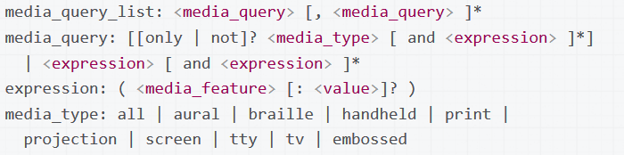
Responsive Design: SYntax
Syntax:
See also: https://developer.mozilla.org/en-US/docs/Web/CSS/Media_Queries/Using_media_queries

Slide 28
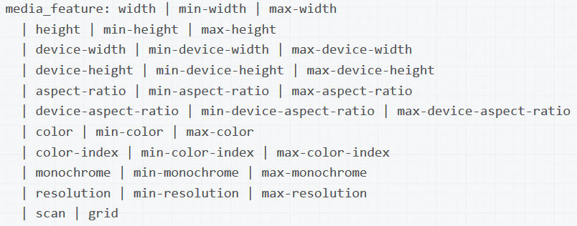
Responsive Design: Media Query Featyres
Source: https://developer.mozilla.org/en-US/docs/Web/CSS/Media_Queries/Using_media_queries

Slide 29
Response DESIGN: Use of media Queries
Can be used in the <HEAD> section of an html document to selectively load a css file
<link rel="stylesheet" media="only screen and (color)" href=“default.css" />
Can also be used within CSS. Note that the media query is a wrapper within which is placed valid CSS.
<!-- CSS media query within a stylesheet -->
<style>
@media (max-width: 600px) {
.img {max-width:256px; }
}
</style>

Slide 30
Libraries
There are many third party open source javascript libraries that can be used to simplify complex tasks
Libraries encapsulate functionality so you only need to know how the library works, for example how to reference it and pass data and parameters to it.
Example of common libraries include
Jquery – a wrapper program that simplifies complex javascript selections
D3 – a data visualization library
Google Maps – an Application Programming Interface that allows you to manipulate geographical information in a browser

Slide 31
javascript
The vast majority of browser programming libraries are written in Javascript.
Browser scripting language, first implemented in 1995 in the Netscape Navigator browser
Javascript is a tool for manipulating the Document Object Model, which is the object model on which html documents are based.

Slide 32
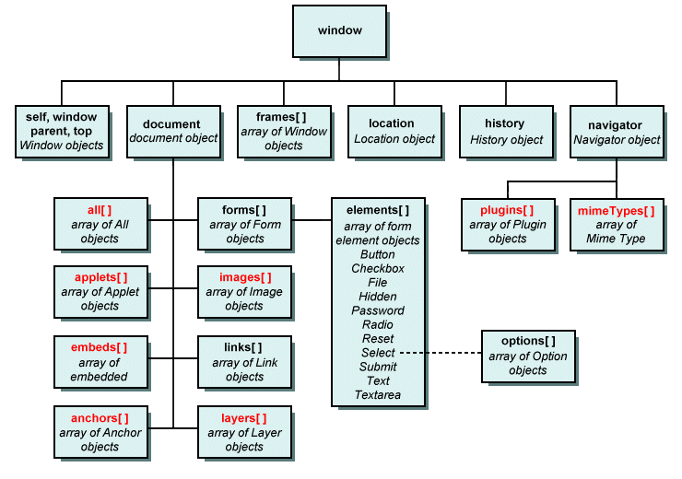
Document Object Model: DOM
Application programming interface (API)
for manipulating html, xml and svg documents.
See also:
https://developer.mozilla.org/en-US/docs/Web/API/Document_Object_Model
Image source: http://www.technologyuk.net/the_internet/web/document_object_model.shtml

Slide 33
Javascript Libraries: Jquery
jQuery was originally written to handle inconsistencies across browsers
jQuery is particularly good at manipulating complex collections of objects in a browser (the DOM)
jQuery is also good at handling asynchronous server requests (ajax)
It is currently used on a majority of the most visited web sites.

Slide 34
JQUERY implementation:
Download from:
https://jquery.com/download/
then place a reference similar to what follows in the header. The specific file reference will vary depending on which version you have downloaded:
<script src="js/jquery-1.11.1.min.js" type="text/javascript"></script>
Alternatively you can access the file directly from the internet
<script src="//code.jquery.com/jquery-1.11.3.min.js"></script>
<script src="//code.jquery.com/jquery-migrate-1.2.1.min.js"></script
Note that jquery-migrate is used to facilitate migrating between different versions of jQuery.

Slide 35
Jquery example: Trapping events and manipulating the DOM
The following code replaces the contents of an iframe with the file name specified by the <li> id.
$(document).ready(function(){
console.log("in document ready");
$("ul").children("li").on("click",function(){
var sTemp=$(this).attr("id")
$("li").removeClass("selected");
$(this).addClass("selected");
$("#example").attr("src",sTemp);
$("#subtitle").html("Example: "+sTemp);
console.log("Menu clicked: "+$(this).attr("id"));
});
});
<header>
<h1>D3 Examples</h1>
<ul>
<li id="force.html">Force 2</li>
<li id="labeled_force.html">Labeled Force</li>
<li id="dendogram.html">Dendogram</li>
</ul>
</header>
<article class="content">
<h2>Various D3 Examples </h2>
<h3 id="subtitle">Example: force_bostock.html</h3>
<div id="iframe-container">
<iframe id="example" src="force_bostock.html“/>
</div>
</article>

Slide 36
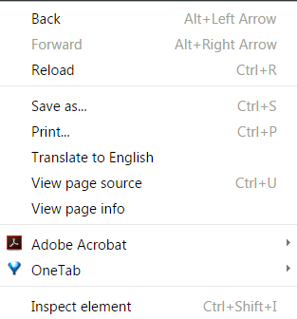
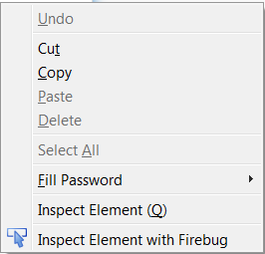
Debugging javascript
In Firefox and Chrome you can access a visual view of your document hierarchy by right clicking your mouse and selecting Inspect Element.

Slide 37
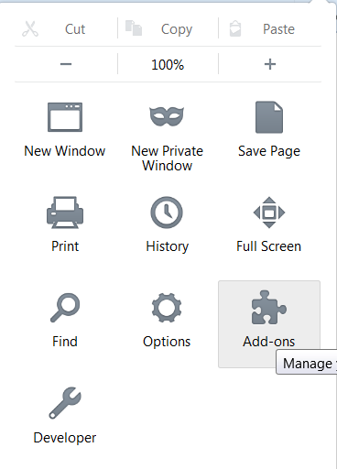
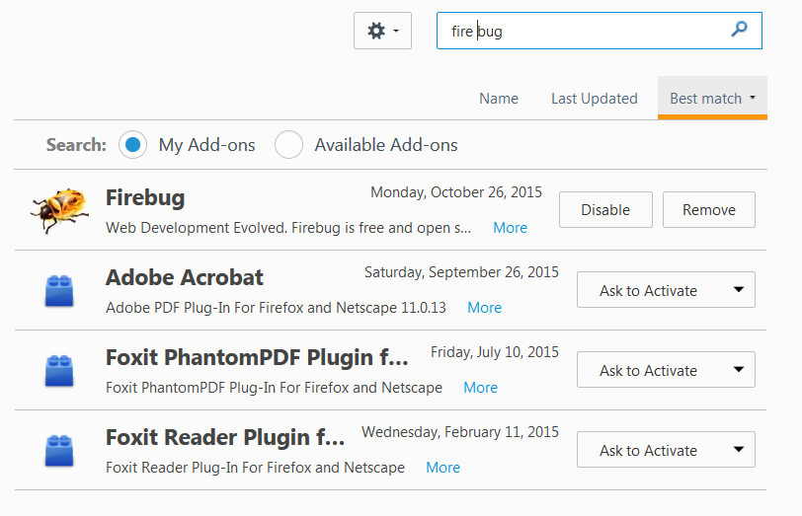
Getting the Fire Bug Add-ON for FIrefox

Slide 38
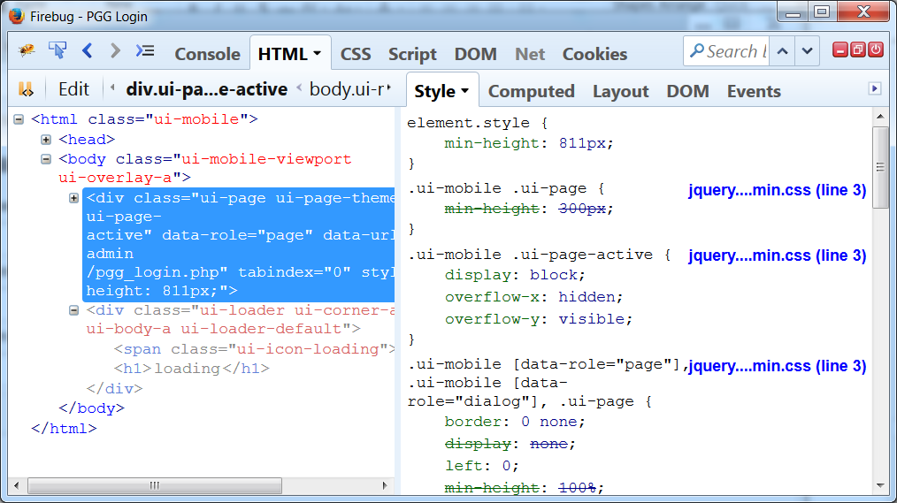
Inspecting HTML element HIerarchy

Slide 39
The D3 javascript Library
A visualization library constructed by Michael Bostock, one of the principal data visualization developers at the New York Times
Open source tool with many extensions
Code base is contained in a github repository. Github is a version control system used by most open source projects, as well as many academics
https://github.com/mbostock/d3/wiki/Gallery

Slide 40
Using D3
D3 is accessed via the D3 library, which can be referenced directly from the internet as follows:
<script src=“//d3js.org/d3.v3.min.js”></script>

Slide 41
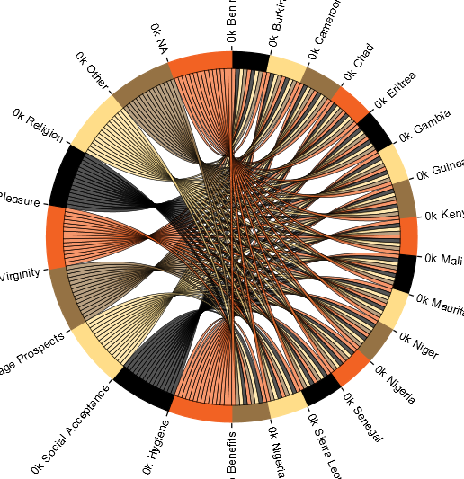
D3 Chord
The chord visualization, designed by Michael Bostock, is an excellent tool for displaying two way relationships within data sets, for example the relationship between riders and destinations.
https://github.com/mbostock/d3/wiki/Chord-Layout
http://www.gghh.name/dibtp/?p=277
http://bl.ocks.org/AndrewRP/7468330

Slide 42
D3 Chord: Initialization
Initialize the chord by assigning and instance of it to a variable (var chord, below)
var chord = d3.layout.chord()
.padding(.00)
.sortSubgroups(d3.descending)
.matrix(matrix);
Initialize height and width and radius variables, which will be applied to the chord object when it is instantiated.
var width = 960,
height = 500,
innerRadius = Math.min(width, height) * .3,
outerRadius = innerRadius * 1.1;

Slide 43
D3 Data
D3 typically uses one of four file formats
Matrix
JSON
XML
CSV

Slide 44
D3 Data: Matrix
Because a chord diagram shows relationships between two points it typically has a symmetrical matrix for input in which the rows for the first part of the matrix correspond with the columns of the second part. The matrix is always square.
var matrix = [
[0,0,0,0,0,0,0,0,0,0,0,0,0,0,0,1,1,1,1,1,1,1,1,1],
[0,0,0,0,0,0,0,0,0,0,0,0,0,0,0,1,1,1,1,1,1,1,1,1],
[1,1,1,1,1,1,1,1,1,1,1,1,1,1,1,0,0,0,0,0,0,0,0,0],
[1,1,1,1,1,1,1,1,1,1,1,1,1,1,1,0,0,0,0,0,0,0,0,0]

Slide 45
JSON
JSON files are text based documents that contain a series of attribute value pairs enclosed in braces {
"nodes":[
{
"x":444,
"y":275
},
{
"x":378,
"y":324
},
{
"x":478,
"y":278
}
]

Slide 46
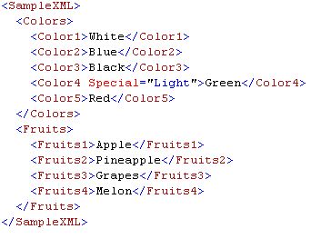
XML
eXtensible Markup Language
Designed to be both human and machine readable.
Similar mark-up rules as HTML, namely that data are stored in a series of nested tags enclosed in <>.
Closing tags begin with a backslash </>

Slide 47
CSV (Comma Separated Values)
A standard export format from Excel
First row is typically a list of column headings
Other delimiters can be used, for example tabs and pipes |
First,Last,Address, City,State,Zip
Brian,MacMillan,99 Shady Grove Lane,New York,New York10040
Jane,Doe,101 Broadway,Parsipanny,New Jersey,00940

Slide 48
D3: Scales and Color in A Chord Diagram
There are two ways to assign color to the chord, either by passing a range of colors to the D3 object:
var fill = d3.scale.ordinal()
.range([
'#00ff00','#ff0000','#ff0000','#ff0000','#ff0000','#ff0000',
'#ff0000','#ff0000','#ff0000','#ff0000','#ff0000','#ff0000',
'#ff0000','#ff0000','#ff0000','#ff0000','##ff0000','#ff0000',
'#ff0000','#ff0000','#ff0000','#ff0000','#ff0000','#ff0000']);
OR by creating a variable that uses one of D3’s built in color sets (category10, category20, category20b)
var fill = d3.scale.category20();
See also http://www.jeromecukier.net/blog/2011/08/11/d3-scales-and-color/

Slide 49
Mapping
Google Maps
JSON
Third party proprietary tools

Slide 50
Google maps: setup
To make Google Maps work you need
To have an internet connection
To add a link to your web page to the Google Maps API
To define a callback program that runs when your code successfully executes

Slide 51
Google Maps: initialization
Calling Google Maps
<script type="text/javascript" src="http://maps.google.com/maps/api/js?sensor=false&callback=initMap"></script>
Sample callback function
var map;
function initMap() {
map = new google.maps.Map(document.getElementById('map'), {
center: {lat: -34.397, lng: 150.644},
zoom: 8
});
}

Slide 52
Google Maps: Markers

Slide 53
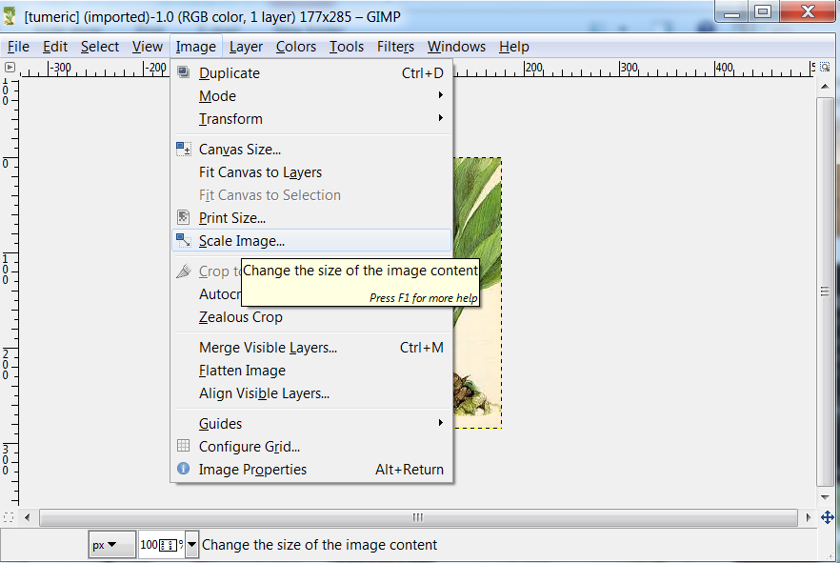
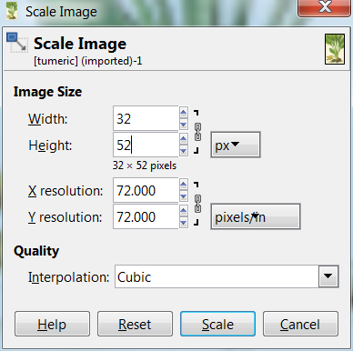
Creating a marker with gimp - I
Open the image you wish to use, using GIMP and then open the Scale Image dialog. Scale to a power of 2, typically a heght/width of 8, 16,32, 64 or 128px

Slide 54
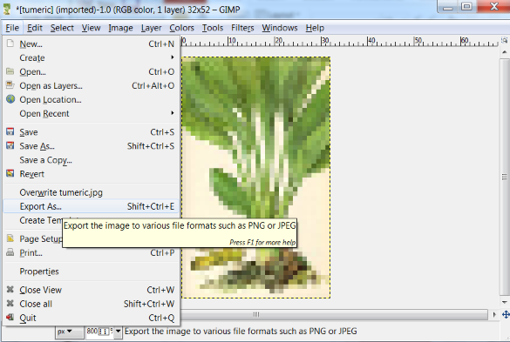
Creating a marker with gimp - II
You need to export the file as a png or jpg. The png format is better, it compresses more efficiently and also has an alpha channel so the results can be transparent.

Slide 55
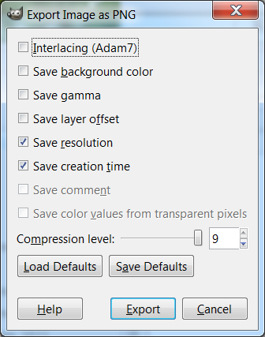
Creating a Marker with gimp: export options

Slide 56
Google Maps: References
https://developers.google.com/maps/documentation/javascript/examples/map-simple
https://developers.google.com/maps/documentation/javascript/examples/marker-simple
https://developers.google.com/maps/documentation/javascript/examples/layer-kml
.
NOTE that Google Maps examples assume that you are using version 2, which requires an API key. Replace this code:
With this code:
<script type="text/javascript" src="http://maps.google.com/maps/api/js?sensor=false&callback=initMap"></script>
<script async defer src="https://maps.googleapis.com/maps/api/js?key=YOUR_API_KEY&signed_in=true&callback=initMap"> </script>

Slide 57
Databases
Under development …

Slide 58
Structured Query Language
A language for retrieving data from relational data management systems like MySQL, Oracle, Sybase, Postgres and Microsoft SQL Server
Codified as ANSI SQL in 1992

Slide 59
Structured Query language
Syntax: SELECT [fieldlist] FROM [tablename] WHERE [condition] ORDER BY [fieldlist] Example: SELECT countryId, gender FROM main WHERE city="Bronx" ORDER BY city DESC; Syntax: SELECT [fieldlist], COUNT(*) As [alias] FROM [tablename] GROUP BY [fieldlist] Example: SELECT countryId, COUNT(*) AS countOfCountry FROM main GROUP BY countryId;

Slide 60
frameworks
Frameworks are collections of libraries that handle multiple tasks, for example the monthly layout of a magazine
Ruby
Struts
Boostrap

Slide 61
Content managers
Drupal
Wordpress

Slide 62
Mapping: Projections

Slide 63
Mapping: Layers

Slide 64
Mapping: Layers

Slide 65
Mapping: ANnotations

